Slide 1


SKILLMATCH RESUME MATCHER AND SKILL RECOMMENDER Milestone-2
Presented by:Seela Harshitha

Slide 2
Problem Statement: • Students struggle to align their skills with job requirements. • Recruiters spend limited time scanning resumes. • Need for an automated tool to analyze resumes and recommend skills/courses.

Slide 3
Objectives:
Analyze resumes and extract skills.
Predict career field (Data Science, Web Dev, Android, iOS, UI/UX).
Recommend missing skills and online courses.
Provide resume improvement tips.

Slide 4
Tools & Technologies Used:
• Python Libraries: Stream-lit, Pandas, NLTK, Spacy, Pyresparser, PDFMiner, Plotly .
• Database: MySQL.
• Frontend: Stream-lit Web App.
• Extra: YouTube integration for videos.

Slide 5
Current Progress:
I have successfully built the resume upload and parsing system.
The application can extract details such as name, email, skills, and number of pages from resumes.
It can predict the career field (Data Science, Web Development, Android, iOS, or UI/UX) based on skills.
A resume scoring feature has been implemented to evaluate resume quality.
The app suggests resume improvement tips and also provides bonus videos for resume writing and interview preparation.

Slide 6

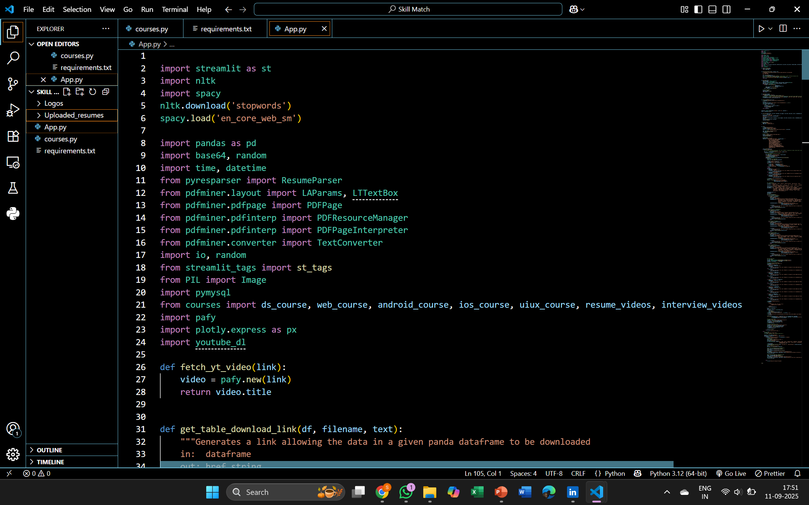

Slide 7
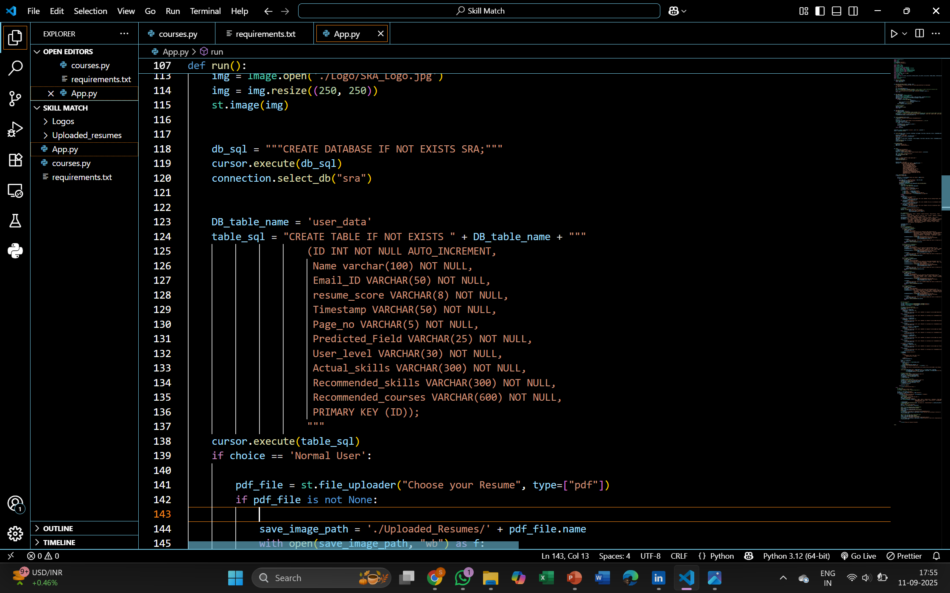

Slide 8
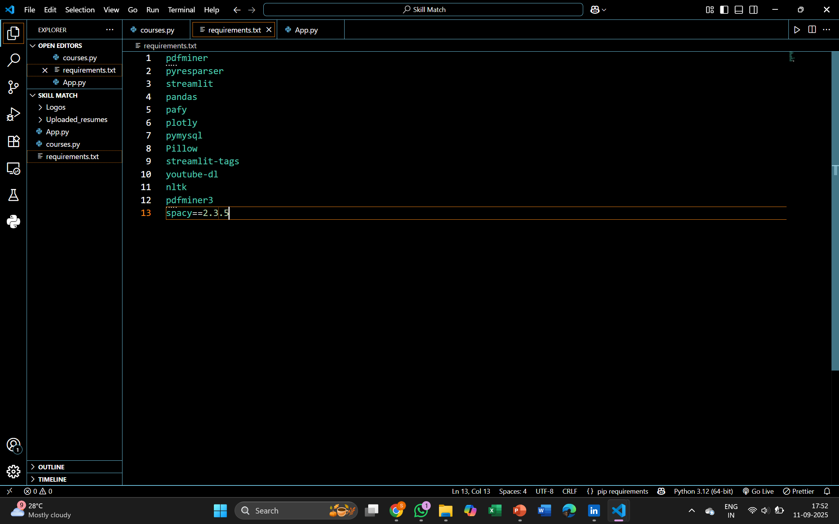

Slide 9
Conclusion:
Project partially completed, core functionality working.
Next steps: polish features, deploy app, improve UI/UX.
In the upcoming stages, focus will be on improving accuracy, adding authentication, enhancing UI/UX, and deploying the application online

Slide 10
Thank You!

